Slide 1
Metamorphic Rocks

Slide 2
By the end of this lesson, you should be able to:
Define a metamorphic rock.
Describe how metamorphic rocks are formed.
Compare and contrast regional and contact metamorphism.
Identify examples of metamorphic rocks in the world.

Slide 3
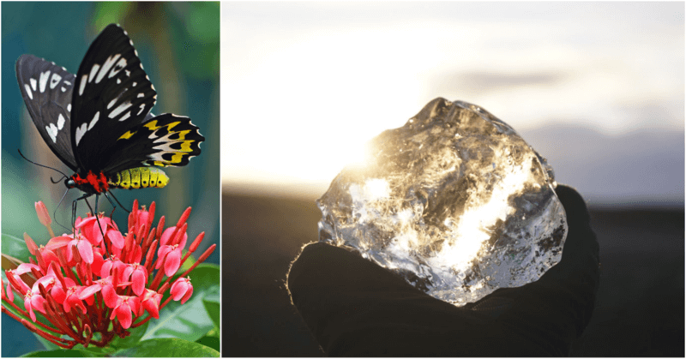
Metamorphic rocks are formed from a process called metamorphism, which is the changing of a rock's composition without melting or eroding it. The process of carbon turning to a diamond is an example of metamorphism.

Slide 4

Metamorphic rocks are made from pre-existing sedimentary rocks, igneous rocks or even other metamorphic rocks.
If these original rocks are exposed to increased temperatures and/or pressures, they can change into new rocks with new properties. The animation below shows the principle of pressure compacting the layers of rock. In metamorphism, this happens deep within the Earth!

Slide 5
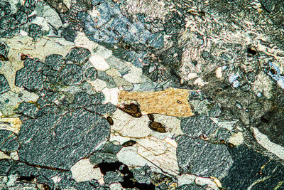
Rocks have to be buried deep inside the Earth to be changed into metamorphic rocks.
Tens of kilometres under the surface, the intense pressure and extreme heat come together to cause metamorphism.
Geologists think that the lower part of the Earth's crust is made out of metamorphic rocks such as eclogite, which is shown below.

Slide 6
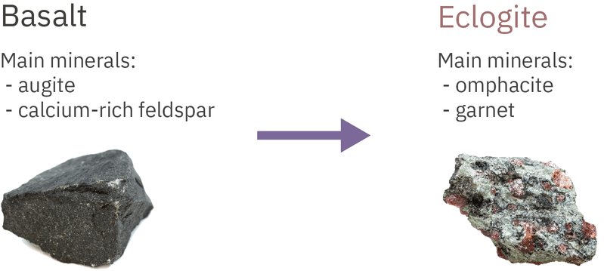
Metamorphism transforms the minerals inside rocks into new minerals.
This means that metamorphic rocks contain different minerals than the original rocks.
Under heat and pressure, the minerals inside a rock exchange chemical elements with each other. No elements are lost or gained by the rock, so the chemical makeup of the whole rock is the same before and after metamorphism takes place.

Slide 7
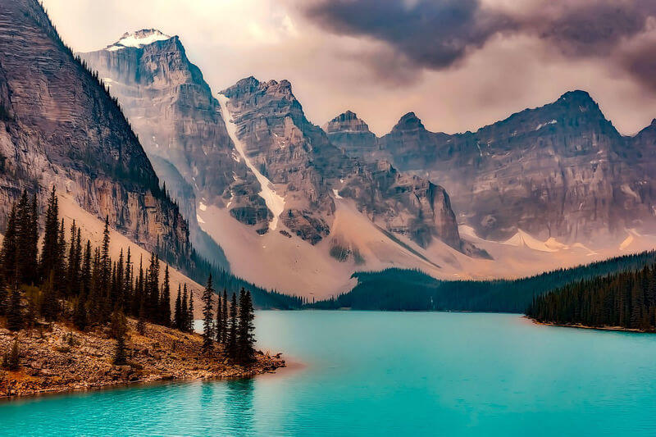
Metamorphism occurs in two ways:
Regional metamorphism (large-scale)
Contact metamorphism (small-scale)

Slide 8

Regional metamorphism occurs when a large area of rock is buried deep within the Earth.
Heat and pressure play equally important roles in altering the minerals inside the rock.
Many mighty mountain ranges, including the Himalayas and the Southern Alps of New Zealand, are made of rocks that underwent regional metamorphism millions of years ago!

Slide 9
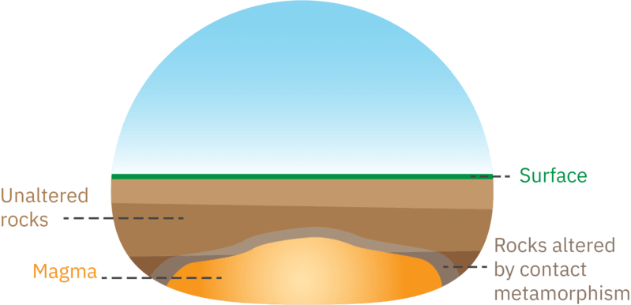
Contact metamorphism occurs on a relatively small scale.
This type of metamorphism takes place when a body of molten rock (i.e. magma) intrudes the Earth's crust. In other words, magma forces its way out of the mantle and into the crust.
The rocks around it are exposed to extremely high temperatures, but relatively low pressures. It's as though the rock has been burned or baked!

Slide 10

Some rocks formed from contact metamorphism include marble and quartzite. Both of these rocks don’t usually show foliation. Marble is made of the mineral calcite, and is formed from the rock limestone.

